Slide 1
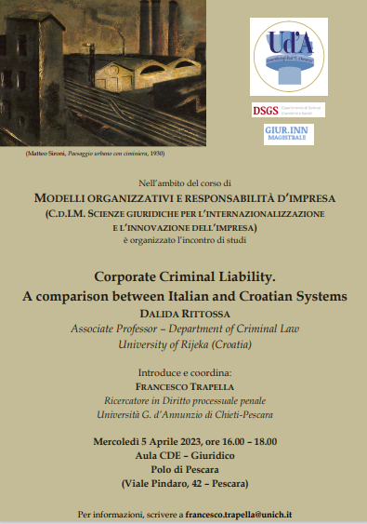


Introduction
Modelli organizzativi e responsabilità d’impresa / B (GIUR.INN.)
Prof. Francesco Trapella

Slide 2


The purpose of the comparison
Comparison
We can highlight only the differences between the systems → insuperable contrast.
(Dividing comparison)
We can highlight the similar purpose and the connection of the two legal disciplines →
(Uniting comparison)

Slide 3
The same question …
Is it correct to provide rules on the responsibility of legal persons for criminal offences?
Need common to both systems – to prevent the legal person from being an instrument of impunity for those who manage it and use it for illicit purposes.
Legacy of the U.S. system (e.g. New York Central & Huston River R.R. vs. United States – U.S. Suprem Court, 1909; Interstate Commercial Act (1887), Elkins Act (1903), Clayton Antitrust Act (1914)).
Legacy of the Europe system
Council of Europe Reccomendations.
EU System (PFI Convention).

Slide 4
… a somewhat similar answer …
Temporal similarity
(i.e. the moment in which the systems have equipped themselves with a set of rules on the legal persons responsibility)
Italy
Legislative Decree no. 231/2001
Croatia
Law no. 151/2003

Slide 5
… with some differences
Italy – Art. 1 Legis. Decree. no. 231/2001.
Entities’ liability for unlawful administrative acts relating to offences.
Croatia – Art. 1 Law no. 151/2003
Prerequisites of punishability, punitive measures and criminal proceedings for criminal offences of legal entities.
Problem of societas delinquere non potest;
Article 27 Italian Constitution (individual criminal responsibility);
Rules to attribute to entity the unlawful act (crimes committed in its interest and to its advantage; it didn’t have a OMM strong enough to avoid the crime; lack of control tools).
Art. 5 Law no. 151/2003 – Responsibility of legal person is based on the guilt of the responsible person.
CRIMINAL VS. ADMNISTRATIVE RESPONSIBILITY

