Slide 1



Corporate Criminal Liability.
A Comparison between Italian and Croatian Systems
Dalida Rittossa, J.S.D.
Associate Professor
University of Rijeka, Faculty of Law

Slide 2

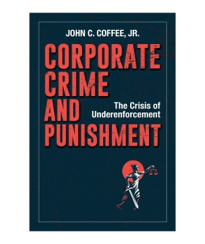


Criminal Liability / Guilt – one of the Basic Concepts of the Criminal Law
Who is criminally liable
Did you ever expect a corporation to have a conscience,
when it has no soul to be damned, and no body to be kicked?
Edward, First Baron Thurlow, Lord Chancellor of Englandm 1731-1806
Societas delinquere non potest!
Only an individual can fulfil actus reus
Mens rea requirement only refers to physical persons
The criminal justice systems impose penalties on individual defendants
Legal persons have no consciousness and no will in the sense of the psychic abilities of humans
We cannot reproach them socially and ethically.
OR…?
Adolf A. Berle, Professor of Law,
Columbia Law School
https://www.law.columbia.edu/faculty/john-c-coffee-jr
a prolific scholar
a sought-after speaker
a frequent news commentator
Corporate Criminal Liability / A Comparison between Italian and Croatian Systems

Slide 3


Criminal Liability / Guilt – one of the Basic Concepts of the Criminal Law
The strongest instrument of state coercion
Call for adaptation to current penal and political requirements.
The need to modernize criminal law
Frankpledge;
Deodant
The “Fimi Media” case – SCRH, I Kž-Us 21/2021.-17
Reactions on the judgment
In October 2021, the Supreme Court of the Republic of Croatia has issued a decision partially confirming the judgement from the repeated proceedings in the "Fimi media" case. According to the decision, the former Prime Minister and HDZ leader Ivo Sanader and co-defendants were found guilty for diverting around 32.923.159,17 kuna (almost 4.39 million €) from state-owned companies and institutions through the Fimi Media marketing agency to the HDZ’s funds from 2004 to 2009.
The Croatian Democratic Union (HDZ) must repay HRK 14.6 million (almost two million euros) and pay a fine of HRK 3.5 million (half a million euros)
For the first time in Croatia, a legal person - political party was declared criminally responsible Art. 291. Abuse of Position and Authority
Plenković: I've no intention of saying sentences
of apology for the sins of others at a time when I
myself was not even a member of the party.
Jandroković: Now, as a legal entity, we are responsible for what happened and we will pay the fine. As for the apology, one must be guilty to be able to apologize, and in this case HDZ is consequently responsible for the actions of individuals. We have paid the political price, we will pay the fine and we bear the political burden, and that is all I can tell you now.
Bačić: Here the party was held responsible for the criminal act of the leading person. Thus, neither was the party declared a criminal organization, as some of our political opponents imply, nor was the HDZ, i.e. its members and officials, declared guilty by this verdict.
https://n1info.hr/english/news/supreme-court-rules-on-fimi-media-sanader-gets-7-years-hdz-fined-3-5m-kuna/
https://balkans.aljazeera.net/teme/2021/10/14/moze-li-se-hdz-ubuduce-nazivati-kriminalnom-strankom
Corporate Criminal Liability / A Comparison between Italian and Croatian Systems

Slide 4
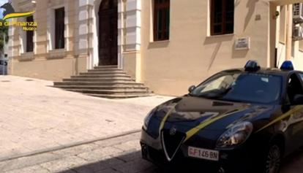
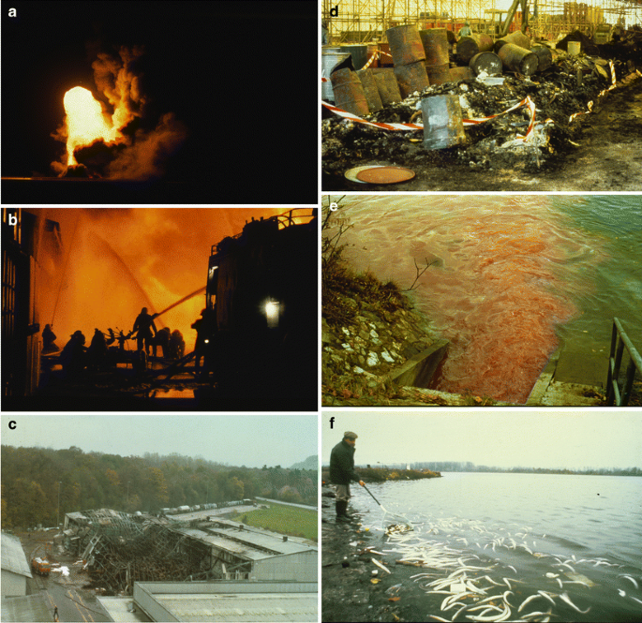
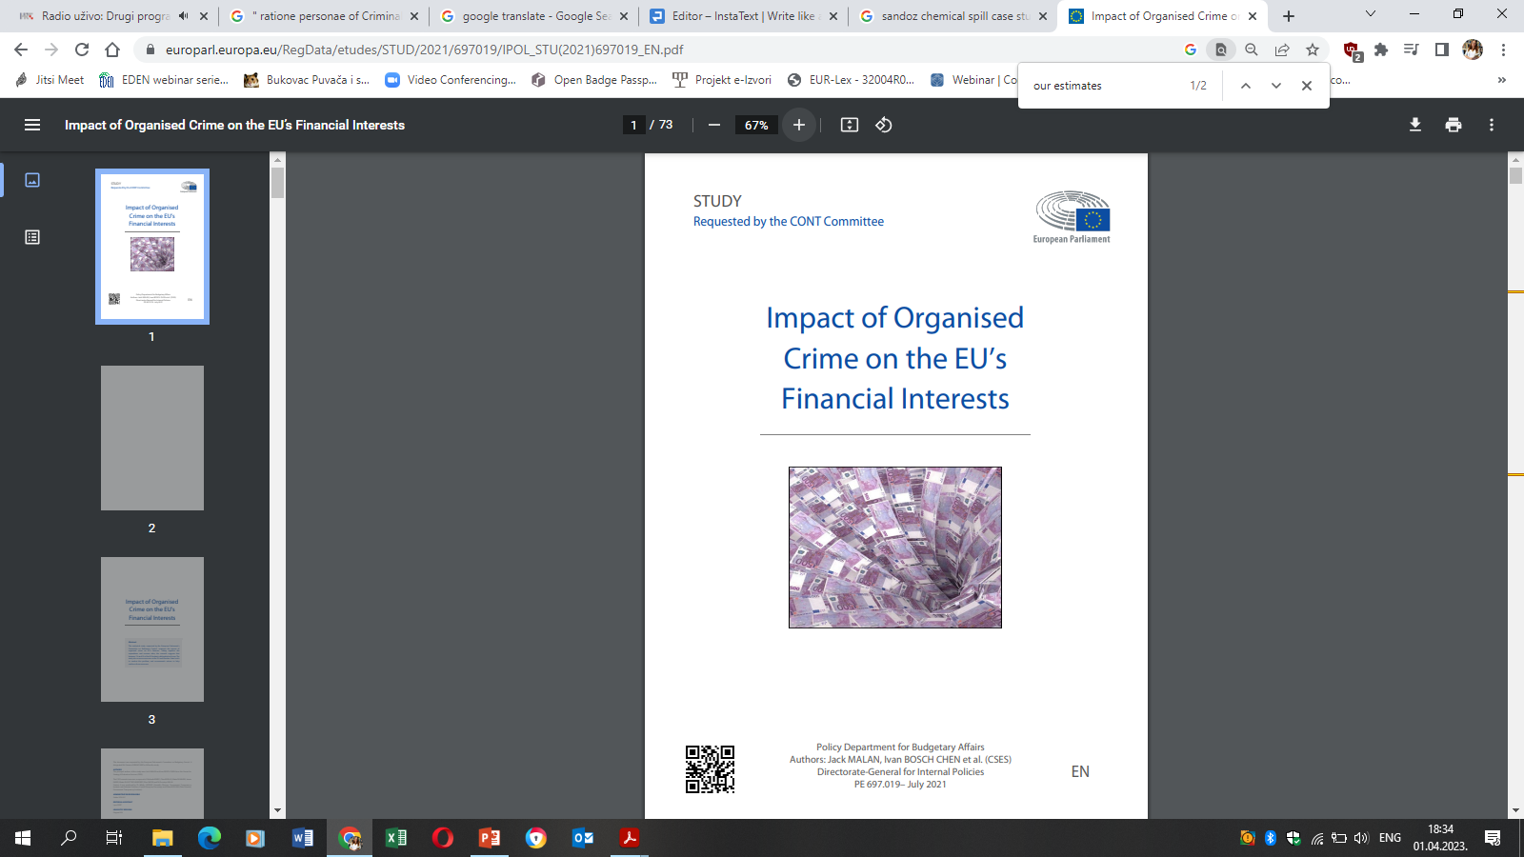
Why Should We include in ratione personae of Criminal Law a legal person – Additional Reasons
COVID-19 and crime patterns?
Over €2 million seized in fraud case regarding EU agricultural funds in Italy
Legal persons do engage in criminal activity
The said criminality generates extremely severe consequences
  great human losses
  endangering the health of a large number of people
  ecological disasters 1986 Sandoz case (chemical spill)
2022 European Public Prosecutor’s Office (EPPO) investigation
the preventive seizure order in Nuoro (Sardinia) and in some neighboring villages
Between 2018 and 2021, 15 Sardinian agricultural companies applied for, and obtained, contributions from the European Agricultural Fund for Rural Development (EAFRD) for the installation of dry-stone in wire mesh closures. It is alleged, however, that the works have not actually been carry out.
severe activities in the field of economic crime
white-collar crime, business crime, occupational crime;
Germ. Wirtschaftskriminalität, Berufskriminalität;
Fren. criminalité des affaires; It. criminalità economica
ANSA; EPPO
Organized Crime on the EU's Financial Interests
Subsidy fraud; Customs import fraud;
Excise Fraud; VAT fraud; Money laundering;
Corruption; Misappropriation; Cybercrime etc.
Never again a Rhine as red as blood
seven years of investigation
only accused - chief of the fire department
sentenced to a fine of 200 francs
public opinion: the "really responsible“ are Sandoz management and the company itself
EU Commission: in 2016 the VAT gap amounted to € 150 billion; € 50 billion of which were defrauded by criminal groups.
Around 2.0 billion to 2.7 billion EUR of EU finances is lost to organized crime
(Malan & Bosch Chen)
Giger, The Rhine red, the fish dead— the 1986 Schweizerhalle disaster,
a retrospect and long-term impact assessment, 2009.
Corporate Criminal Liability / A Comparison between Italian and Croatian Systems

Slide 5
Liability of Legal Persons in European Criminal Law Framework
Common Law systems traditionally recognize criminal liability of legal persons
European legal area
  Is the criminal liability is more effective than administrative liability?
  EU competition law has highly effective, more severe administrative sanctions than national criminal legislation
no uniform level
At the end of the day, a fine is a fine for a company, and the absolute amount is more important than its label.
Csonka & Landwehr, 2019
A. Countries that impose CLLP
CLLP is contrary to constitutional provisions
- criminal punishment is provided exclusively for natural persons according to the principle of guilt
CLLP is contrary to criminal law provisions
- the responsibility of legal persons is contrary to criminal law dogmatic and the classicistic principle of guilt, which is based on the free will of the individual and the social-ethical reproach
B. Countries with no CLLP
CLLP is not contrary to both constitutional and criminal law provisions
- It is assumed that the introduction of criminal liability of legal persons would not lead to incompatibilities with positive legal principles or institutes.
Corporate Criminal Liability / A Comparison between Italian and Croatian Systems

Slide 6

Liability of Legal Persons in European Criminal Law Framework
A. Countries that impose CLLP
A prevailing tendency
B. Countries with no CLLP
The United Kingdom
Germany
Criminal offenses committed by legal persons are punished by regulatory fines under the German Act on Regulatory Offenses (OWiG)
the Draft of Corporate Sanctions Act (Verbandssanktionengesetz; VerSanG) provided a new framework for CLLP after years of work, the project collapsed in the summer 2021!
  a political scandal
  a breach of the coalition agreement
  a political decision in the light of upcoming September 26 federal elections
Regulatory offences (strict liability) – 19 ct.
CLLP – theory of identification – 20 ct.
Croatia, 2004
The Netherlands, 1950; 1976
Art. 51, Para. 1. of the CC
“Criminal offenses can be
committed by physical and legal persons.”
Portugal, 1984
Decree-Law no. 28/84
Luxemburg, 2010
Art. 34 of the CC
“The criminal liability of legal persons does not
exclude that of natural persons who are co-
offenders or accomplices of the same offences.”
France, 1994; 2004
Art. 121-2 of the CC
“Legal persons, with the exception of the State, are criminally
liable for offences committed on their account by their organs or
representatives.”
Corporate Criminal Liability / A Comparison between Italian and Croatian Systems

Slide 7







A Number of Models of the Corporate Criminal Liability
Depending on the basic liability characteristics
Basic characteristics of liability
Accessory; Indirect; Classical
Direct; Organized
Derived v. Autonomous
Objective v. Subjective
Cumulative v. Subsidiary
The responsibility of a legal person is derived, extracted, accumulated from individual criminal responsibility (guilt) of its organs or responsible persons who are natural persons.
There must be a connection between the conduct of a natural person and a legal person, manifested in the fact that the natural person acted: a) within the scope of their duties, b) on behalf of the legal person, c) for the benefit of the latter.
Actus reus + consequence = no need to determine a subjective element of crime (regulatory offences in UK = strict liability)
Croatian legal theory = strict opposition to objective criminal responsibility. Criminal law is a subjective legal discipline. The subjective attitude of the offender towards their act and its consequences has to be determined.
both the natural, responsible person and the legal person are responsible for the same criminal act = parallel perpetratorship (not co-perpetratorship, Incitement or aiding)
the established liability of one person excludes the liability of another
attribution
of guilt
corporation
Derived subjective
Autonomous subjective
organizational deficits
failure to supervise
corporate mens rea
corporate culture
Corporate Criminal Liability / A Comparison between Italian and Croatian Systems

Slide 8
The Corporate Criminal Liability in Croatia – A Tail of Normative Evolution
1954 - Legal framework governing the economic contraventions
1973 Amendments to the Act on Economic Contraventions
1977 Act on Economic Contraventions
2003 Act on the Responsibility of Legal Persons for the Criminal Offences
- Confiscation
- Political connotations
- 1946/’48 – nationalization
= Dead letter
Case law
criminal offences
contraventions
In force 24/03/2004
2nd WW
misdemeanors
2002
- Primary responsibility of a legal person
criminal offences + misdemeanors
Vacatio legis = 6 months
The model of subsidiary responsibility
Cumulative responsibility
Cumulative responsibility
Cumulative responsibility
Corporate Criminal Liability / A Comparison between Italian and Croatian Systems

Slide 9


The Corporate Criminal Liability in Croatia -2003 Act
Criminal Code
Criminal Procedural Code
The Law on the Office for the Suppression of Corruption and Organized Crime
lex specialis derogat legi generali – subsidiary application of the
The basic issues covered by the norms on criminal responsibility
2° Criminal Liability Model
If the legal person ceases to exist before the completion of the criminal proceedings criminal responsibility of its general legal successor
Criminal liability of the legal person in bankruptcy
1° Ratione Personae
Subjective, Derived Liability
Legal persons with criminal liability = national and foreign according to the Croatian law
– secret associations,
partnerships and certain
NGOs are excluded)
The Republic of Croatia –excluded (Art. 6, Para. 1)
Local and regional self-government when executing public authority – excluded
Art. 3, Para. 1
The legal person shall be punished for a criminal offence of a responsible person if such offence violates any of the duties of the legal person or if the legal person has derived or should have derived illegal gain for itself or third person.
Art. 5, Para. 1
Responsibility of legal person is based on the guilt of the responsible person.
Ius puniendi belongs only to the state!
Absurd situation
Para 2
Fines would flow from one part of the state budget to another
The legal person shall be punished for the criminal offence of the responsible person also in cases when the existence of legal or actual obstacles for establishing of responsibility of responsible person is determined.
When acting iure imperii
When acting iure gestionis /
equal actors in economic
activities
immunity, amnesty or pardon
death, procedural incapacity, impossibility
to identify the perpetrator – responsible person
presumed guilt of the
responsible person
Corporate Criminal Liability / A Comparison between Italian and Croatian Systems

Slide 10


The Corporate Criminal Liability in Croatia -2003 Act
The basic issues covered by the norms on criminal responsibility
3° National persons who commit prohibited actions
4° Criminal offences
crime
Art. 3, Para. 1
The legal person shall be punished for a criminal offence of a responsible person…
Art. 4.
The responsible person within the meaning of this Act is a natural person in charge of the
operations of the legal person or entrusted with the tasks from the area of operation of the legal person.
powers of representation and conclusion of legal transactions on behalf of a legal entity
Art. 3, Para. 2
Under the conditions referred to in paragraph 1 of this Article the legal person shall be punished for the criminal offences prescribed by the Criminal Code and other laws prescribing the criminal offences.
broader concept / depending on the structure and division of tasks within the legal person
unlimited circle of criminal offences
* there is almost no criminal offence
which could not be committed
by a legal person, at least in the role
of participant
* the number of criminal offences
dictated by the international
and EU law is constantly growing
Corporate Criminal Liability / A Comparison between Italian and Croatian Systems

Slide 11
The Corporate Criminal Liability in Croatia -2003 Act
Duration: one to three years after the court judgement becomes final
Types of Criminal Sanctions:
Except for: local and regional government and political parties
Punishments
Security Measures
Fine
criminal offence is punishable by imprisonment for a term of up to one year fine of 660,00 to 1.061.780,00 €
criminal offence is punishable by imprisonment for a term of up to five years fine of 1990,00 to 1.327.220,00 €
criminal offence is punishable by imprisonment for a term of up to ten years fine of 3980,00 to 1.592.670,00 €
criminal offence is punishable by imprisonment for a term of up to fifteen years or longer fine of 6630,00 to 1.990.840,00 €
Termination of the
legal person
the legal person has been established for the purpose of committing criminal offences or
if the same has used its activities primarily to commit criminal offences
Except for: local and regional government and political parties
Process of termination follows
the court may impose one or more of the following security measures:
prohibition of performance of certain activities or transactions
  further performance of certain activities or transactions would be a danger to life, health or security of persons, or hazardous to property, or economy, OR
  person has already been punished for the same or similar criminal offence
prohibition of obtaining of licenses, authorizations, concessions or subventions
prohibition of doing business with beneficiaries of state and local budgets
  in case of a danger of encouraging the commission of a new criminal act
Suspended sentence
The term of probation – 1 to 3 years
The fine to be suspended – less than 6636,14 €
Corporate Criminal Liability / A Comparison between Italian and Croatian Systems

Slide 12
The Corporate Criminal Liability in Croatia – Phenomenological Perspectives
Amendments to the ARLPCO
New Criminal Code!
Corporate Criminal Liability / A Comparison between Italian and Croatian Systems

Slide 13
The Corporate Criminal Liability in Croatia – Phenomenological Perspectives
Corporate Criminal Liability / A Comparison between Italian and Croatian Systems

Slide 14
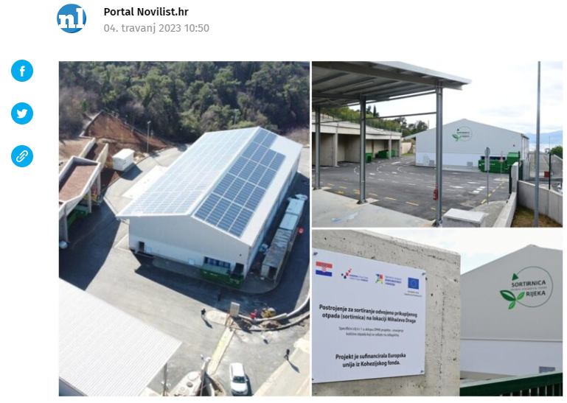
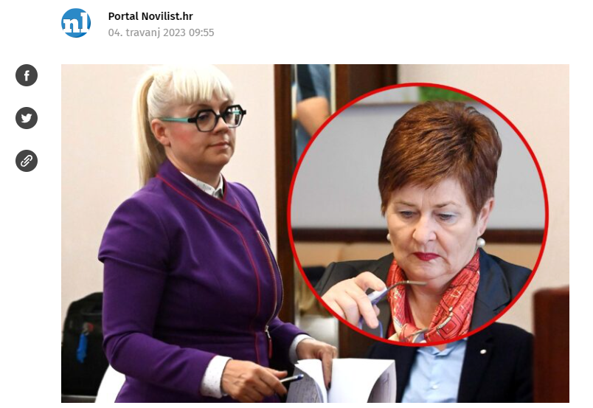
The Corporate Criminal Liability in Croatia – A Step Forward?
Significant, frequent amendments of the criminal law framework
  The 2003 Act was amended in 2007, 2011, 2012 and 2022
EPPO action in Rijeka! The former head Milicevic and director of communal company Čistoća Kukuljan were arrested, and the third was advisor Ropac
Consequences for legal certainty?
In the area of Rijeka and Međimurje this morning were arrested several persons suspected of embezzlement from the EU Cohesion Fund. The action is carried out by order of the European Public Prosecutor's Office (EPPO).
Urgent investigative measures are carried out with the aim of gathering evidence. The facts under review relate to five persons and one commercial company suspected of criminal acts in the form of abuse of position and authority in connection with public procurement procedures under the project for the construction of a facility for the sorting of collected waste in Mihačeva Draga.
A need for robust, cohesive and functional legal system with theoretically approved criminal liability of legal persons
  Corporate liability = one of the most complex legal issues
  clear and transparent mechanism for CLLP
  to target the most responsible
  With the system of protection for collateral victims
Novi list, https://www.novilist.hr/novosti/crna-kronika/akcija-eppo-a-u-rijeci-uhicene-bivsa-
procelnica-milicevic-i-direktorica-cistoce-kukuljan-a-treci-je-savjetnik-ropac/
Corporate Criminal Liability / A Comparison between Italian and Croatian Systems

