Slide 1



The Social Dangerousness
Dalida Rittossa, J.S.D.
Associate Professor
University of Rijeka, Faculty of Law

Slide 2
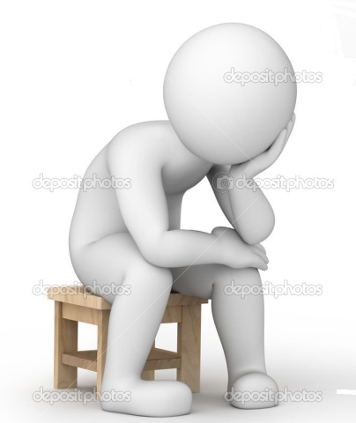

Incorrect behavior, annoys other patients, is disobedient, intolerant of discipline, cries over nothing, has a tendency to steal [...]. It is very difficult to make an accurate judgment about the state of his mental abilities, because the patient hardly or insufficiently responds to the questions addressed to him. Thus, the reporter could only get him to say nothing more than his name and age [...] he does not obey even the most elementary commands [...] very little attention. Prof. Mingazzini knows the patient and considers him a moral lunatic: Anamnesis and behavior confirm this. Certainly he is a severe imbecile who shows marked antisocial tendencies: today he is dangerous to himself, tomorrow perhaps to others.
Pinel,
by the beginning of 19 c..
Moral insanity
Prichard,
1835
His admission to a mental hospital is therefore
considered justified, adding to what has
already been said the absolute lack of emotional
feelings, so that as a whole he is affected by
one of the most severe forms of deficiency,
with impulsive, amoral tendencies.
As the son of an alcoholic, his path in life is
clearly marked: the future will show if and
to what extent education can improve him
and if one day he can return to society
without posing danger to it.
Livi,
1876
Historical genesis of the concept of “Social Dangerousness”?
= madness consisting in a morbid
perversion of the natural feelings,
affections, inclinations, temper,
habits, moral dispositions, and
natural impulses, without any
remarkable disorder or defect of
the interest or knowing and
reasoning faculties, and
particularly without any insane
illusion or hallucinations.
= a morbid, true, real, visible, palpable fact
in the insane asylums, a chronic
disease of the brain, [...] is born
with the unfortunate person who
carries it, and never cures;
the morally insane person
was born predisposed,
formed by nature
to misbehave, hence [...]
moral insanity has
particular morbid causes,
among which the hereditary bad disposition stands out.
Mental examination from the medical records of Giovanni C., a nine-year-old boy who was admitted to the Santa Maria della Pietà Institution in Rome in May 1903. (Sannini, 2014)
Tamburini,
1876
1876, Martino Beltrani Scalia’s administrative act approved “a section for maniacs” at the penal institution in Aversa
= necessity to introduce forensic psychiatric institutions for criminals
Foucault, 2009
Sannini, 2014
The acts infringe criminal
and natural law norm
Psychiatry as a basis to construct social control.
Social security measures
/
Social defense
Forensis psychopathology / Pericolosità sociale e accertamento penale

Slide 3
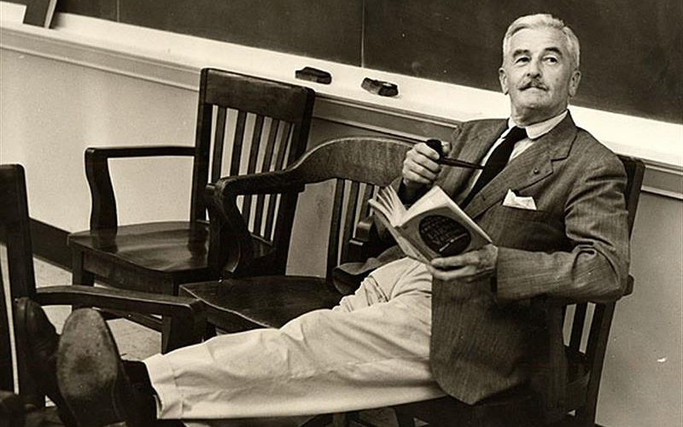
Social Dangerousness
Normal v. Abnormal
“Sometimes I ain’t so sho who's got ere a right to say when a man is crazy and when he ain’t. Sometimes I think it ain’t none of us pure crazy and ain’t none of us pure sane until the balance of us talks him that-a-way. It's like it ain’t so much what a fellow does, but it's the way the majority of folks is looking at him when he does it.”
William Faulkner, As I Lay Dying, 1930
Forensis psychopathology / Pericolosità sociale e accertamento penale

Slide 4
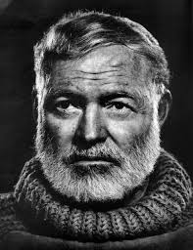
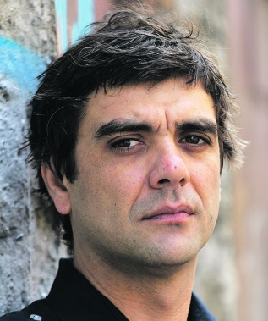
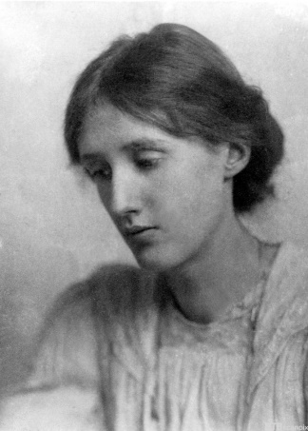


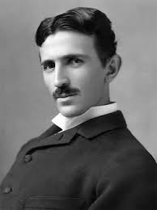

Normal v. Abnormal?
Ernest
Hemingway
Miss Misery on the island of Susak
Bekim Sejranović
Bipolar disorder (Manic depression)
Bipolar disorder, alcohol dependence,
traumatic brain injury, and probable
borderline and narcissistic personality traits, depression, psychosis
Ludwig van Beethoven
Bipolar disorder
  Virginia
  Woolf
Bipolar disorder
Nikola Tesla
Obsessive compulsive disorder
  Bruce
  Springsteen
Depression
John Forbes Nash
Schizophrenia
Forensis psychopathology / Pericolosità sociale e accertamento penale

Slide 5

Social Dangerousness and Free Will?
Idealism
Free will of man = full freedom of choice, independent of all influences, external and internal motives.
The commission of a crime is always the result of the perpetrator's free choice, and criminal responsibility is a moral responsibility.
If we punish the criminal, we respect them as a reasonable human being.
  Hegel and his followers
  Italian Positivist School
Criminal offence – guilt – punishment.
Absolute indeterminism
Fatalistic approach
Absolute determinism
Free will is completely denied, it is a mere automatism, i.e. the result of certain endogenous or exogenous factors.
The commission of a crime is a compelled behavior, and consequently there is no criminal liability as a moral category.
The mental basis of imputability does not exist because the will is completely subordinated to the lethal effect of causation.
A social, legal responsibility is constructed on the fact that perpetrator’s behavior endangers other members of the social community.
Responsibility is thus not suppressed, as the followers of the Classical School think, but it is "modified in moral interpretation." Madness knows no excuses.
Psychiatry functions as a specialized branch of public [...] hygiene, institutionalized as a measure of social security. (Foucault, 2009)
Offender – dangerousness – social security measures.
No. of compulsory detention in Italy (Sannini, 2014)
1865 | 1874 | 1881 | 1898 | 1914
7700 | 12210 | 18000 | 36873 | 54311
"Sherlock Holmes Program 3A"
Forensis psychopathology / Pericolosità sociale e accertamento penale

Slide 6



Monistic system of sanctions with a clear line of following the classical doctrinal principles, however
Art. 46, Para. 1 and 2 reads as follows: The person who, at the time of the commission of the crime, was "in such a state of mental incapacity that he was deprived of his conscience and of the freedom of his actions" is not liable to punishment. The judge may, with the acquittal, order the "surrender to the competent authority according to the provisions of the law" if the judge considers him dangerous.
The 1890 Supreme Court of Cassation decision: Art. 46, Para. 2 establishes a public order measure to ensure the safety of citizens and, at the same time, the safety of acquitted persons (a back door security measure?).
The Criminal Code of Zanardelli, 1889
  RELATIVE DETERMINISM /
  RELATIVE INDETERMINISM
Individuals who are dangerous to others or to themselves or who are
A part of a public scandal
The Act of Giolitti, 1904
The Code Rocco was the first Italian legal source to entrust the treatment of the acquitted classified as socially dangerous under the jurisdiction of the criminal judge.
Classical and positivistic elements built in “a higher system capable to meet real and effective needs of society and the state” (Alfredo Rocco).
Punishment + security measures = dualistic system of sanctions
The principle of quilt rules the punishment.
The principle of specialization of the security measure in relation to the particular social danger of people and the principle of individualization govern the security measures. / Section VIII.
Security measures are a sort of administrative, police measures to protect not to punish, and therefore, discretionary, revocable, and, as a rule, indeterminate.
Conditions for security measures: 1) criminal offense (/impossible offense, unsuccessful act of incitement + 2) social dangerousness (Art. 202);
Socially dangerous is a person, even if not criminal liable or punishable, who has committed one of the acts referred to in the preceding article, if it is likely that he will commit new acts that are provided by law as crimes (Art. 203, Para. 1);
Socially dangerous groups: 1) mentally immature and mentally ill 2) morally corrupt;
An absolute presumption of dangerousness and automatic committal to a judicial psychiatric institution for acquitted persons for mental incapacity if the crime was intentional or non-intentional, punishable by death penalty or life imprisonment or imprisonment exceeding two years + indeterminate duration = monistic system of sanctions?
The mentally incompetent are always socially dangerous?
=
The constitutional understanding of man as a bearer of freedoms and rights!
/
Forensis psychopathology / Pericolosità sociale e accertamento penale

Slide 7
Individual’s Dangerousness in Croatian Criminal Law
  The Principle of Guilt = No one may be punished unless he/she is guilty of the committed criminal offence.
* prohibition from holding an office or engaging in an activity, * prohibition from driving a motor vehicle, * prohibition from approaching a person,
* removal from the shared household, * prohibition from accessing the internet
Mental competence
Intention / Negligence
Consciousness of wrongdoing (guilty knowledge)
Lack of excusable reasons
Content of guilt
exceeding the limits of self-defense due to
excusable great fear caused by the attack;
necessity as an exclusion of guilt;
Art. 24 of the CC
Mental Incompetence
(1) A mentally incompetent person is not guilty and cannot be imposed punishment.
(2) A mentally incompetent person is a person who at the time of commission of an unlawful act was incompetent of comprehending the meaning of his/her actions or of exercising control over his/her will due to mental illness, temporary mental disorder, insufficient mental development or some other graver mental disorder.
The provisions of the Act on the Protection of Persons with Mental Disorders shall apply to a person who committed an unlawful act in a state of mental incompetence.
Forensis psychopathology / Pericolosità sociale e accertamento penale

Slide 8
Individual’s Dangerousness in Croatian Criminal Law
  Diminished Mental Competence – A separate institute / YES or NO?
The effect of mental disorder
A perpetrator who tempore criminis was, by reason of a state referred to in Art. 24, Para. 2, of a substantially diminished mental competence may be punished less severely.
MENTAL COMPETENCE
GRADUAL
REDUCTION OF
COGNITIVE AND
VOLUNTARY
COMPETENCES
DIMINISHED MENTAL COMPETENCE
Guilt
Punishment
SUBSTANTIALLY DIMINISHED MENTAL
COMPETENCE
+ Safety measure of mandatory psychiatric treatment, Art. 68. Para. 1.
criminal offence punishable by imprisonment of one year or more +
danger that due to the mental disorder that caused his/her substantially diminished mental competence this person might commit a more serious criminal offence in the future
MENTAL INCOMPETENCE
Forensis psychopathology / Pericolosità sociale e accertamento penale

Slide 9
The County Court of Varaždin, 5 K. 353/16-28 from 3 October 2016
  In the family of the accused there had been a disturbed relationship for a long time. Namely, the defendant was firmly convinced that his wife and son were working against him and wanted to "get rid of him" in order to sell the house he had built himself. Unable to withstand this pressure, one day in July he took a knife from the kitchen drawer and, raising his hand, approached his son and wife without a word. He pushed them into a corner and just stared at them, whereupon his son shouted, "Well, are not you going to slaughter us now?" The woman managed to get out of this position, she pulled her son behind her and they both ran away and waited for the police in front of the house. They told that the defendant was acting very strangely, as if he was not sober. During the criminal proceedings, the court found, based on the findings and the opinion of the psychiatric expert, that the defendant tempore criminis suffered from a delusional disorder due to which he could not understand the meaning of his actions or control his actions. Due to the delusional content of his thoughts, he lost contact with reality. The effects of the mental illness were so severe that the defendant felt protected from his family members during his stay in pretrial detention.
Mentally incompetent
The ability to reason and to control one's own will is excluded.
Mental illness
Forensis psychopathology / Pericolosità sociale e accertamento penale

Slide 10
The County Court of Zagreb, 17 Kmp-8/14 from 20 November 2014
  The defendant was born as a child with limited intellectual abilities and was diagnosed with a number of psychophysical disorders (pervasive developmental disorder, ADHD, underdeveloped speech, motor disorder) and at the time of puberty a form of epilepsy. His inadequate development was also influenced by the fact that he grew up in a dysfunctional family that could not cope with the fact that they had a disabled child. He graduated from elementary school under a special program for children with special needs, is permanently unable to work, withdrew into himself, and began to overeat, resulting in obesity. On one critical day, he verbally clashed with his mother, who forbade him to make a sandwich after lunch. She threatened to take away the freshly cut slices of bread from him, but the defendant, still holding the kitchen knife, immediately reacted and stabbed her in the stomach with the same knife. Based on a psychiatric report, the court found that the defendant was under high emotional tension due to his borderline intelligence, which is due to a cerebral dysfunction, and a previous bad relationship with his mother, all of which led to a significant reduction in his ability to understand his own actions and control his own will.
insufficient mental development + temporary mental disorder
Substantially diminished ability to reason and to control one's own will
Substantially diminished mental competence
Forensis psychopathology / Pericolosità sociale e accertamento penale

Slide 11

The Social Dangerousness and the Role of Forensic Psychiatry in Protection of People with Mental Illnesses
Forensis psychopathology / Pericolosità sociale e accertamento penale

Slide 12

  Even in a community of angels who are unfailingly committed to obeying legal norms, differing conceptions of good, self-interest or mere accidents would necessitate institutions to authoritatively resolve disputes. Yankah citing Joseph Raz (1975)
  Under traditional philosophical view, typical legal systems – legal systems made by humans to address human needs – are contingently coercive.
  The legal basis for forensic psychiatry is a group of norms that regulate the legal status of a person with a mental disorder.
Forensic Psychiatry and the Architecture of Norms
compulsory detention
criminal liability
right to marriage
forced medication
legal and contractual capacity
parental rights
right to drive
right to bear arms
Forensis psychopathology / Pericolosità sociale e accertamento penale

Slide 13

The History of Forensic Psychiatry – Data Points and Landmarks
If you have clearly ascertained that [the defendant] is in such a state of insanity that he is permanently out of his mind and so entirely incapable of reasoning, and no suspicion is left that he was simulating insanity when he killed his mother, you need not concern yourself with the question how he should be punished…he should be kept on close observations and, if you think it advisable, even kept in restraint.
Neolithic times – trephining the skull to release evil spirits that inhabit one’s head and caused psychopathology
Under Marcus Aurelius, a lunatic might be restrained by relatives. If he escaped and did harm, the relatives might be
executed = “kinship malpractice”; Gutheil (2005)
Plato - Those who are ‘mad’ because of illnesses are to be kept inside, firmly under the control of their family members.
Unlike other citizens, they are not held responsible for the offences they may commit, and it is their family members
who pay a fine if they fail in their duty to guard them.
4 main issues
Macer, 180 A.D., Mulay & Waugh (2019)
What century is this analysis from?
The phenomenon of mental illness in a social context
An insane person ... is legally incapable of malicious intent, and the power to insult, and therefore the action for injuries cannot be brought against him.
Corpus Juris Civilis
Tests to assessing madness?
Legend of the retired Roman general, Cincinnatus:
In order to escape the task of leading an army, Cincinnatus fake madness by hitching up his plow and sowing salt as if it were seed. The delegates, suspecting a trick, placed the infant grandchild of Cincinnatus in the path of the plow, and when he turned the plow aside, they concluded simulation.
Forensis psychopathology / Pericolosità sociale e accertamento penale

Slide 14
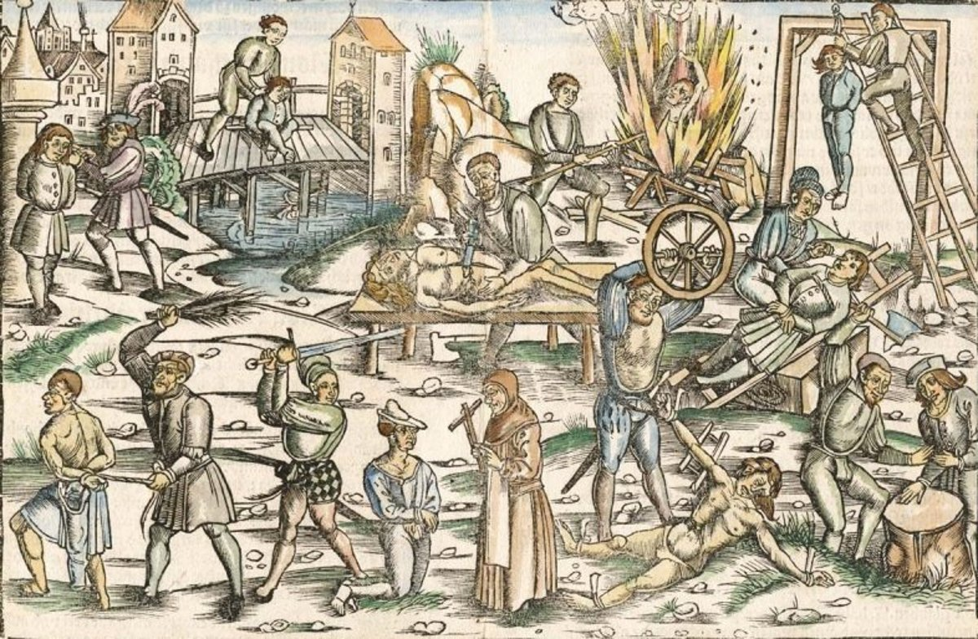
The History of Forensic Psychiatry – Data Points and Landmarks
Medieval statutory law in Croatia
late 16th century Florence (Magherini G, Biotti, 1998):
Weak-minded
Mentally ill
Deaf and mute
Women
Minors
Strangers
Madness = devil’s possession
Witch execution (Benedict Carpzov
and 20000 death penalties for witchcraft; the last
one in Germany 1775)
short on brains
lacking brains
nuts
madman
crazy
insane
demented
stupid in the brain
out of his mind
raving
fatuous
out of his feelings
ruled by humors, delirious and affected by mania
• 17th century Europe (Foucault, 1961):
• Late 18th century England (Eigen, Andoll 1986):
• Immanuel Kant’s classification of mental disorders (White, 2012):
Confining the insane, on a large scale: Hotel – Dieu, an institution to deprive of liberty the insane together with the poor, petty criminals, vagrants, prostitutes etc.
The evidence of mental disorder: statement of the accused, family members, neighbors and in less that 1/3 cases – medical experts
madness (amentia), insanity (dementia), delirium (insania), and lunacy (vesania, he also categorized as "unreason")
• Emil Kraepelin’s thesis: (Wetzell, 1991):
Philippe Pinel, in 1792 as a chief physician at the Paris asylum for men, Bicêtre, made his first bold reform and unchained patients, many of whom had been restrained for 30 to 40 years. Two years later he did the same for female patients in Salpêtrière.
Forensic psychiatry is a research-based medical specialty.
crime = antisocial act; punishment= protective measures
both the criminal and the lunatic were the necessary products of heredity and milieu
no need to assess the accused’s criminal liability
all who "violate[d] the conditions for the happy existence of human society“ = “dangerous”
Forensis psychopathology / Pericolosità sociale e accertamento penale

Slide 15
The Abused of Psychiatry – What Has History Thought us?
Highly complex causes (Fulford et al.):
  social and political pressures
  a lack of democratic tradition
  poor standards of clinical training and practice
  inadequate procedural quality assurance
  inadequate public awareness
  inadequate legislature
  inadequate scientific precision of the disease
  model and diagnostic criteria
Patients’ rights violation
Confining people for their political beliefs
Punitive use of psychiatric medications
Oppressions of intellectuals and scientists
It will take some time to learn that the role of the mental health profession in a democratic society is to be technical advisers on the degree of disorder and risk to the legal system, not an "instrument" of abuse guarding this political system.
Helen Lavretsky, 1998
Forensis psychopathology / Pericolosità sociale e accertamento penale

Slide 16

The Standards and Mechanisms of Ensuring the Rights of Psychiatric Patients within the Convention for the Protection of Human Rights and Fundamental Freedoms
ARTICLE 3
Prohibition of torture
No one shall be subjected to torture or to inhuman or degrading treatment or punishment
ARTICLE 5
Right to liberty and security
Everyone has the right to liberty and security of person. No one shall be deprived of his liberty save in the following cases and in accordance with a procedure prescribed by law:
(…)
(e) the lawful detention of persons for the prevention of the spreading of infectious diseases,
of persons of unsound mind, alcoholics or drug addicts or vagrants;
Forensis psychopathology / Pericolosità sociale e accertamento penale

Slide 17
M.S. v. Croatia (no. 2), Application no. 63993/00, 20 October 2005
For several years the applicant had been under the supervision of, and had been receiving various types of financial assistance amounting to some 600 Croatian kunas (HRK) per month from, a local social care centre. She was a person with polymorphic health issues.
On 29 October 2012 the applicant went to see her family doctor complaining of severe lower-back pain. Her doctor, after having examined her, called the emergency health service and sent the applicant for some further medical checks. In the emergency service, she was diagnosed with lumbago and sent the applicant for further medical checks by a neurologist. On the same day, the neurologist made a diagnosis of back pain and anxiety disorder, and sent the applicant for a further examination by a psychiatrist. The psychiatrist found that she was making fanciful and confusing allegations of persecution by various doctors and made a diagnosis of acute psychotic disorder, systemic delusional disorder and delusional dysmorphic disorder, and prescribed hospitalization.
The applicant was immediately admitted against her will to a psychiatric clinic where she was forcibly tied to a bed with four belts tightened around her ankles and wrists in an isolation room and forcefully injected with a strong drug. She was kept in that position until the next morning and felt severe pain in her back. A county court subsequently ordered her continued confinement in the clinic in a decision after 10 minutes hearing. The involuntary confinement was ordered until 28 November 2012. The decision was upheld by a three-judge panel, despite the applicant’s request for her discharge and complaints of ill-treatment in the clinic. The applicant addressed a handwritten complaint to the director of the hospital and the director of the R. Clinical Hospital Centre, dated 8 November 2012, however, the complaint was never forwarded to the hospital’s director or any other competent hospital authority. The applicant was discharged a month after her forced hospitalization (on 29 November 2012).
A violation of
procedural aspects of
Art. 3
Prohibition of torture
The complaint in writing to the hospital administration of ill-treatment during the applicant’s involuntary confinement and the pain suffered as a consequence of physical constraint for 15 hours, supported by medical documentation, raised an arguable claim of ill-treatment. This has triggered the authorities’ obligation to conduct an effective official investigation. However, the complaints were not examined by the domestic courts or forwarded to other competent authorities for further investigation.
Forensis psychopathology / Pericolosità sociale e accertamento penale

Slide 18
M.S. v. Croatia (no. 2), Application no. 63993/00, 20 October 2005
Seclusion and other forms of coercive and non-consensual measures against patients with psychological or intellectual disabilities have to be employed as a matter of last resort and when their application is the only means available to prevent immediate or imminent harm to the patient or others. Developments in contemporary legal standards require:
  adequate safeguards against abuse including sufficient procedural protection
  sufficient justification that the requirements of ultimate necessity and proportionality have been complied with
  all other reasonable options failed to satisfactorily contain the risk of harm to the patient or others
  the measure was not prolonged beyond the period strictly necessary for that purpose
ART. 3 SUBSTANTIVE
STANDARDS
The applicant’s medical records did not suggest that
  she posed any immediate or imminent harm to herself or others or
  that she had been aggressive in any way
  any alternative means had been tried, that physical restraint had been used as a matter of last resort, or that the measure had been necessary and proportionate in the circumstances
The fact that she may have given incoherent information about her health issues could not in itself justify the use of measures of physical restraint.
The restrained had not been effectively and adequately monitored.
A violation of
substantive aspects of
Art. 3
Prohibition of torture /
Inhuman and degrading
treatment
The requirements of necessary “legal assistance” for persons confined on the ground of “unsound mind”
  a legal aid lawyer acted as a passive observer during the hearing (he did not meet the applicant, provide her with legal advice or make submissions on her behalf)
  the competent domestic courts, although aware of the lawyer’s omissions, had failed to take appropriate measures to secure the applicant’s effective legal representation
  although the judge conducting the proceedings had visited the applicant in hospital, he had made no appropriate adjustments to secure her effective access to justice (informing her of her rights or considering the possibility for her to participate in the hearing)
A violation of
Art. 5 § 1 (e)
Right to liberty
and security
(habeas corpus)
Forensis psychopathology / Pericolosità sociale e accertamento penale

Slide 19

Associate Professor, Dalida Rittossa
Department of Criminal Law
University of Rijeka, Faculty of Law
Hahlić 6, 51000 Rijeka, Croatia
dalida.rittossa@uniri.pravri.hr
Forensis psychopathology / Pericolosità sociale e accertamento penale

