Slide 1



Social Dangerousness and Crime Prevention. National and International Standards.
Dalida Rittossa, J.S.D.
Associate Professor
University of Rijeka, Faculty of Law

Slide 2

Social Dangerousness and Crime Prevention
Prisoners = vulnerable
Psychiatric patients = vulnerable
Why do people commit criminal offences?
      Biological factors
      Societal factors
      Mixed theories
Why do we become socially dangerous?
How can we ameliorate and / or erase
dangerousness of the offenders?
Prisoners with mental health issues
Compulsory detained psychiatric patients
= particularly vulnerable
Criminological theories
State positive obligations
In time of crisis…
SUPPORT SERVICES FOR VULNERABLE
operational
upgraded
dissemination of information
access to already established
services
Thinking of the general public
Incapacitation
Exclusion from the community
Placement in psychiatric institutions
Imprisonment
prevention of vulnerable group
rights violation
National standards +
International standards
Forensis psychopathology / Pericolosità sociale e accertamento penale

Slide 3
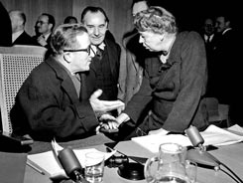
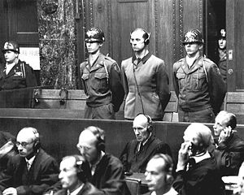
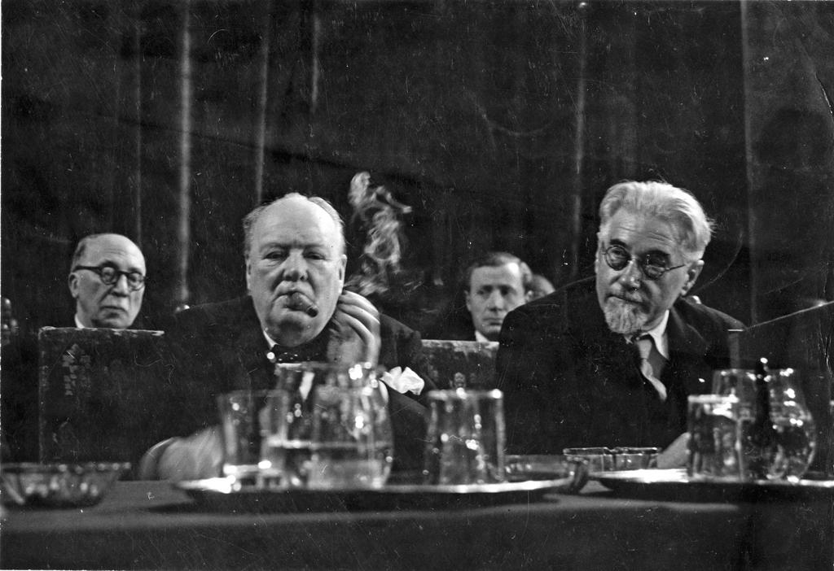
International Standards and Mental Health – A Historical Overview
1. The voluntary consent
of the human subject is
absolutely essential
Here I cannot believe like a clergyman or think as a Jurist.
I am a doctor and I see the law of nature as being the law of reason.
10. The scientist in charge must be prepared
to terminate the experiment at any stage if there is
a probable cause of injury, disability, or death
The 2nd World War
9. The human subject should be at liberty
to bring the experiment to an end
2. Fruitful results for the
good of society
1947 Nuremberg Code
1.
Refer to individual legal issues
Legally binding for all categories of persons
8. Scientifically qualified persons with
the highest degree of skill and care
3. Anticipated results will
justify the performance
of the experiment
7. Proper preparations and adequate
facilities should be provided
4. Avoiding all unnecessary physical
and mental suffering and injury
5. Where there is an apriori reason to believe
that death or disabling injury will occur, perhaps,
the experimental physicians also serve as subjects
6. The degree of risk should never exceed that determined
by the humanitarian importance of the problem
2.
1) Universal Declaration of Human Rights,1948
2) The European Convention on Human Rights, 1950
3) International Covenant on Economic, Social and Cultural Rights, 1966
4) International Covenant on Civil and Political Rights, 1966
The 2nd World War
recognition of a wide range of rights and freedoms of all citizens, and therefore, of persons with mental disorders
The Law for the Protection of
Hereditary Health
T-4 -The euthanasia programme
Forensis psychopathology / Pericolosità sociale e accertamento penale

Slide 4

International Standards and Mental Health – A Historical Overview
1. The same rights as other human beings
6. The mentally retarded person has a right to protection from exploitation,
abuse and degrading treatment. If prosecuted for any offence,
he shall have a right to due process of law with full recognition being given to
his degree of mental responsibility.
2. A right to proper medical care and physical therapy
and to such education, training, rehabilitation and
guidance as will enable him to develop his ability and
maximum potential
7. The procedure used for that restriction or denial of rights must contain proper
legal safeguards against every form of abuse. This procedure must be based on
an evaluation of the social capability of the mentally retarded person by
qualified experts and must be subject to periodic review and to the right of appeal to higher authorities
3. A right to economic security
and to a decent standard of living
4. A right to live with his own
family or with foster parents
and participate in different forms
of community life
3.
15. Admission principles
16. Involuntary admission
a qualified mental health
practitioner authorized by law
determines a mental illness and
a serious likelihood of
immediate or imminent harm
to that person or to other persons
in the case of severe mental
illness and impaired judgement,
failure to admit or retain that
person is likely to lead to a serious
deterioration in his or her condition
or will prevent the giving of
appropriate treatment
1) Declaration on the Rights of Mentally Retarded Persons,1971
2) Principles for the Protection of Persons With Mental Illness and the Improvement of Mental Health Care, 1991
5. A right to a qualified guardian
The 1970s of the 20th
1. Fundamental freedoms and basic rights
2. Protection of minors
recognition of rights and creation of mechanisms for the protection of persons with mental disorders as a special category of citizens
3. Life in the community
4. Determination of mental illness
5. Medical examination
Every patient shall have the right to be treated
in the least restrictive environment and with the least
restrictive or intrusive treatment appropriate to the
patient's health needs and the need to protect
the physical safety of others.
11. Consent
8. Standards of care
12. Notice of rights
6. Confidentiality
9. Treatment
7. Role of community and culture
13. Rights and conditions in mental health facilities
(…)
10. Medication
14. Resources for mental health facilities
Forensis psychopathology / Pericolosità sociale e accertamento penale

Slide 5

1) WHO Resolution WHA28.84, on Promotion of of Mental Health, 29. 05. 1975.
2). WHO Resolution EB61.R28 on Review of the Medium-Term Programme for Mental Health, 24. 01.1978.
3) WHO Resolution WHA32.40 Development of the WHO programme on alcohol-related problems, 25. 05. 1979.
4) WHO Resolution WHA33.27 Action in respect of international conventions on narcotic and
psychotropic substances: Abuse of narcotic and psychotropic substances, 23. 05. 1980.
5) WHO Resolution WHA39.25 on Prevention of Mental, Neurological and Psychosocial Disorders, 16. 05.1986.
6) WHO Resolution CD40/15 Mental Health, 08. 07. 1997.
7) WHO Resolution WHA55.10 on Mental Health: Responding to the Call for Action, 18. 05. 2002.
8) WHO Resolution CD47.R1 (2006) - Disability: Prevention and Rehabilitation in the Context of the Right, 25. 09. 2006.
9) WHO Resolution CD49.R17 Strategy and Plan of Action on Mental Health, 28. 09. 2009.
10) WHO Resolution EB130.R8 on Global Burden of Mental Disorders and the Need for a Comprehensive, Coordinated Response from Health and Social Sectors at the Country Level, 20. 01. 2012.
11) WHO Resolution SEA/RC65/R8 Comprehensive and coordinated efforts for the management of autism spectrum disorders (ASD) and developmental disabilities, 07. 09. 2012.
12) WHO Resolution WHA66.8 on Comprehensive Mental Health Action Plan 2013–2020, 27. 05. 2013.
13) WHO Resolution WPR/RC65/5: Mental Health, 28. 08. 2014.
14) WHO Resolution: The European Mental Health Action Plan, 28. 08. 2014.
15) WHO Resolution EB136.R8 Global burden of epilepsy and the need for coordinated action at the country level to address its health, social and public knowledge implications, 02. 02. 2015.
16) WHO Resolution CD54.R11 Strategy and plan of action on dementias in older persons, 28. 09. 2015.
17) WHO Resolution WHA72: Comprehensive Mental Health Action Plan 2013-2030, 26. 01. 2019.
18) WHO Resolution WHA73.10 Global actions on epilepsy and other neurological disorders, 13. 11. 2020.
19) WHO Resolution EB148(3) - Promoting mental health preparedness and response for public health emergencies. 20. 01. 2021.
4.
The 1970s of the 20th Century
WHO Resolutions to promote mental health
Forensis psychopathology / Pericolosità sociale e accertamento penale

Slide 6

International Standards and Mental Health – A Historical Overview
1. The aim of psychiatry
5. No procedure must be performed or treatment
given against or independent of a patient's own will,
unless the patient lacks capacity to express his or
her own wishes or, owing to psychiatric illness,
cannot see what is in his or her best interest or, for
the same reason, is a severe threat to others.
8. Confidentiality
2. The best therapy available
due to the dignity of al human beings
and to their autonomy
9. Clinical research
10. Withdrawal from
voluntary treatment or research
Clarence D D Blomquist
3. A therapeutic relationship between
patient and psychiatrist is founded
on mutual agreement
to reconcile the various member
countries on issues of misuse of psychiatry
raise the quality of psychiatric care
throughout the world
to speak in terms of constitutional rights
to leave paternalistic approach based on
Hippocratic ethics and avoid strict legalism
6. The conditions have ceased to exist /
the end of compulsory treatment
4. The informed consent
7. Prohibition of maltreatment / The psychiatrist must not
participate in compulsory psychiatric treatment in the absence of
psychiatric illness.
1. Clinical practice
5.
2. Psychiatric education
1) The Declaration of Hawaii, 1977
2) The Madrid Declaration on Ethical Standards for Psychiatric Practice, 1996
3) The Declaration of Craiova, 2204; Cairo, 2006
4) WPA Code of Ethics for Psychiatry, 2020
143 WPA member states,
but only 15 codes of ethics
few of these were associated
with professional disciplinary processes.
these codes are rarely revised and
sometimes supplemented with
other statements and guidelines
Bloch, Kenn, Lim (2022)
3. Psychiatric research
4. Psychiatric publication
The 1970s of the 20th Century
5. Promotion of public health and public mental health
Ethical standards of the psychiatric profession in the declarations of the World Psychiatric Association / The international code of ethics of psychiatry
‘in accordance with local law’ when necessary
Compulsory treatment
- less restrictive intervention cannot achieve safe and adequate care; its purpose is to ultimately to promote and re-establish patient’s autonomy and welfare
Forensis psychopathology / Pericolosità sociale e accertamento penale

Slide 7


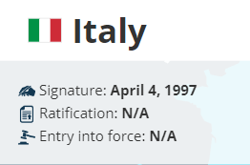
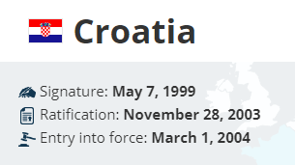


International Standards and Mental Health – On the Threshold of the New Millennium
  The Convention for the Protection of Human Rights and Dignity of the Human Being with regard to the Application of Biology and Medicine: Convention on Human Rights and Biomedicine (1997)
  The Convention on the Rights of Persons with Disabilities (2006)
Signature: 30 Mar 2007
Ratification: 15 May 2009
Signature: 30 Mar 2007
Ratification: 15 Aug 2007
Forensis psychopathology / Pericolosità sociale e accertamento penale

Slide 8


The Convention on the Rights of Persons with Disabilities
a turning point in the protection of the rights
of persons with disabilities
is an evolving concept that results from the interaction between persons with impairments and attitudinal and environmental barriers that hinders their full and effective participation in society on an equal basis with others.
Preamble (e)
disability
Persons with disabilities include those who have long-term physical, mental, intellectual or sensory impairments.
Art. 1
Forensis psychopathology / Pericolosità sociale e accertamento penale

Slide 9

The Convention on the Rights of Persons with Disabilities
Basic Principles
  Respect for inherent dignity, individual autonomy including the freedom to make one's own choices, and independence of persons;
  Non-discrimination;
  Full and effective participation and inclusion in society;
  Respect for difference and acceptance of persons with disabilities as part of human diversity and humanity;
  Equality of opportunity;
  Accessibility;
  Equality between men and women;
  Respect for the evolving capacities of children with disabilities and respect for the right of children with disabilities to preserve their identities.
The Committee on the Rights of Persons with
Disabilities – a monitoring body
Forensis psychopathology / Pericolosità sociale e accertamento penale

Slide 10
The Implementation of International Standards in national Law – Croatia Experience
The legal position of persons with mental disorders in Croatia until the adoption of the 1997 Law on Protection of Persons with Mental Difficulties
Law on Non-Contentious Procedure
Law on Health Care and Health Insurance
Law on Health Care
1934
1980
1993
Legal framework was partial, inadequate, outdated and in most cases it was not applied
Forensis psychopathology / Pericolosità sociale e accertamento penale

Slide 11


The 1997 Law on Protection of Persons with Mental Difficulties
  An important legal mechanism that regulates the legal, medical, and social status of people with mental disorders and
    serves to protect people with mental disorders
    contains well-known and generally accepted international standards that decades earlier formed the basis for the legal status of these individuals in most Western European and American countries.
Forensis psychopathology / Pericolosità sociale e accertamento penale

Slide 12


The 2014 Law on Protection of Persons with Mental Difficulties
  High standards of convention law are incorporated
    Recognition of the autonomy of a person with mental disorders
    Recognition of the right to self-determination
    Protection of mental integrity
    Priority of the welfare of the individual over the interests of society
Section III
RIGHTS OF PERSONS WITH MENTAL DISABILITIES
BASIC PRINCIPLES
Forensis psychopathology / Pericolosità sociale e accertamento penale

Slide 13
Winterwerp v. The Netherlands, Application no. 6301/73, 24 October 1979
  In 1968, Mr. Winterwerp, the applicant, was involuntarily hospitalized in the Zon an Schild psychiatric hospital in Amersfoort in an emergency procedure by order of the competent burgomaster in charge, after events occurred that made it clear that he needed psychiatric help. Six weeks later, at the request of his wife, Mr. Winterwerp was forcibly placed in the same hospital by order of the competent Amersfoort District Court after the conclusion of the regular court proceedings.
  In the course of time, the forced confinement was periodically extended by the Regional Court at Mrs. Winterwerp’s further requests and subsequently on application by the public prosecutor on the basis of the monthly records of the doctors who had successively treated Mr. Winterwerp. According to medical records, the applicant showed schizophrenic and paranoiac reactions, he was unaware of his pathological condition and, on several occasions, he had committed quite serious acts without appreciating their consequences.
  Mr. Winterwerp submitted requests for suspension of the compulsory detention to the hospital authorities, which duly forwarded them to the competent public prosecutor. In 1969, the public prosecutor forwarded the first application to the Regional Court, which denied it after hearing Mr. Winterwerp at the psychiatric institution. The prosecutor rejected the other three requests without referring them to the Regional Court for decision because it appeared manifestly impossible to grant them.
  Mr. Winterwerp automatically lost the capacity to administer his property on being detained in a psychiatric hospital. It seems that, at the beginning, his affairs were managed by his wife, and later, a guardian was nominated by the Regional Court.
  Mr. Winterwerp submitted an application to the ECtHR, complaining that he was being arbitrarily deprived of his liberty, that he had not been allowed a hearing by a court and that he had not been informed of the decisions by which his confinement was several times prolonged.
  The procedure by which his compulsory confinement was decided violated the provisions of the EC. In particular, he pointed out that he was never questioned before the various courts that ruled on his case and that he had neither legal counsel nor the opportunity to challenge the medical findings and opinions. In considering Mr. Winterwerp's application, the Commission unanimously concluded that the circumstances of the case indicated that Mr. Winterwerp's rights under Art. 5, Para. 1 of EC had not been violated, but that there had been a violation with respect to rights under Art. 5, Para. 4 of EC. In the further course of the proceedings, the ECtHR addressed the question of whether the deprivation of Mr. Winterwerp's liberty could be justified by Art. 5, Para. 1, letter e), because he was a "mentally ill person", and whether the decisions of the Public Prosecutor's Office not to forward Mr. Winterwerp's applications for release to the competent court resulted in a violation of the rights referred to in Art. 5, Para. 4, because the facts for which the compulsory placement was determined could be subsequently changed.
Forensis psychopathology / Pericolosità sociale e accertamento penale

Slide 14
Winterwerp v. The Netherlands, Application no. 6301/73, 24 October 1979
  A. "The lawful detention of persons of unsound mind“
  The EC does not state what is to be understood by the words "persons of unsound mind". This is a term whose meaning is continually evolving as research in psychiatry progresses, an increasing flexibility in treatment is developing and society’s attitude to mental illness changes. However, state authorities cannot detain a person simply because their views or behavior deviate from the norms prevailing in a particular society.
  There must be a medical declaration to the effect that the person concerned "is in a state of mental illness and that it is necessary or desirable to treat him in a psychiatric hospital“. The Netherlands courts authorise the confinement of a "mentally ill person" only if his mental disorder is of such a kind or of such gravity as to make him an actual danger to himself or to others.
  B. "In accordance with a procedure prescribed by law“
  The notion underlying the term in question is one of fair and proper procedure, namely that any measure depriving a person of his liberty should issue from and be executed by an appropriate authority and should not be arbitrary.
  C. The alleged right to treatment
  A mental patient’s right to treatment appropriate to his condition cannot as such be derived from Art. 5 Para. 1 (e).
Criteria for lawfulness of detention
*objective medical expertise + * m.d. a kind or degree warranting compulsory confinement + *the validity of continued confinement depends upon the persistence of such a disorder
No violation of Art. 5 Para. 1 (e).
Right to liberty and security
Forensis psychopathology / Pericolosità sociale e accertamento penale

Slide 15
Winterwerp v. The Netherlands, Application no. 6301/73, 24 October 1979
  A. As concerns the initial direction to detain made by the burgomaster and the subsequent orders issued by the District Court and the Regional Court
  The very nature of the deprivation of liberty under consideration would appear to require a review of lawfulness to be available at reasonable intervals. Neither the burgomaster, who made the initial direction to detain, nor the public prosecutor, who prolonged its validity, can be regarded as possessing the characteristics of a "court". The intervention of a body will satisfy Art. 5 Para. 4 (art. 5-4) only on condition that "the procedure followed has a judicial character and gives to the individual concerned guarantees appropriate to the kind of deprivation of liberty in question"; "in order to determine whether a proceeding provides adequate guarantees, regard must be had to the particular nature of the circumstances in which such proceeding takes place"
  A person of unsound mind has a right to present his own case and to challenge the medical and social evidence adduced in support of his detention. In view of his special situation, he has a right to be legally assisted. It is essential that the person concerned should have access to a court and the opportunity to be heard either in person or, where necessary, through some form of representation. Mental illness may entail restricting or modifying the manner of exercise of such a right. The applicant was never associated, either personally or through a representative, in the proceedings: he was never notified of the proceedings or of their outcome; neither was he heard by the courts or given the opportunity to argue his detention case.
  B. As concerns the applicant’s requests for discharge
  Each time the public prosecutor declines to communicate a request to the Regional Court on the ground that it appears evidently ill-founded, he is not merely restricting but effectively denying the right to court proceedings as embodied in Art. 5 Para. 4 (art. 5-4). His decisions cannot be qualified as decisions taken by a "court“.
  C. As concerns the applicant’s alleged failure to seek legal representation
  Having "substantial and well-founded grounds for denying the lawfulness of [the] detention" cannot be a pre-condition for access to the proceedings contemplated by Art. 5 Para. 4, since this is precisely the issue that the domestic court should decide.
Violation of Art. 5 Para. 4
Right to liberty and security
Forensis psychopathology / Pericolosità sociale e accertamento penale

Slide 16
Winterwerp v. The Netherlands, Application no. 6301/73, 24 October 1979
  A. As concerns loss of civil capacity
  The applicant lost the capacity to administer his property on his confinement in a psychiatric hospital. There had been no court hearing in compliance with Art. 6 Para. 1 of the Convention.
  Neither in law nor in practice was Mr. Winterwerp afforded the opportunity of being heard, either in person or through a representative. What is more, that procedure was concerned solely with his deprivation of liberty. Consequently, it cannot be taken as having incorporated a "fair hearing", within the meaning of Art. 6 Para. 1, on the question of his civil capacity.
  While mental illness may render legitimate certain limitations upon the exercise of the "right to a court", it cannot warrant the total absence of that right as embodied in Art. 6 Para. 1.
Violation of Art. 6 Para. 1
Right to a fair trial
All-embracing
&
Fully inclusive society
Social exclusion and neglect
Separation
Integration
Full socio-political inclusion
Forensis psychopathology / Pericolosità sociale e accertamento penale

